Slide 1

Work Status, Cognitive Function, and Dementia
Jonathon Hirschi
Statistical Consulting, Spring 2022
Client: Dr. Ronica Rooks, CU Denver

Slide 2

Project Background and Motivation
Alzheimer’s disease and related dementias are an area of increased research given the aging population
The scientific literature has determined several factors that increase the risk of developing dementia, including racial disparities where black adults are at a higher risk
Productive work is hypothesized to reduce cognitive decline and rates of incident dementia

Slide 3


Study Description
The Health, Aging, and Body Composition (HABC) study tracked the mental and physical status of 3,075 black and white adults over 11 years
Modified Mini-Mental State Exam (3Ms)
All adults were considered community-dwelling and highly functional
Patient characteristics were recorded in year one, and many variables were observed in further years
https://healthabc.nia.nih.gov/

Slide 4

Analysis Goals
Build dataset from HABC data
Calculate time until dementia diagnosis for each participant
Construct a variable of amount of time working for pay
Build a survival analysis statistical model to estimate the relationship between working for pay and rates of incident dementia
General methodology builds off of Yaffe 2013

Slide 5
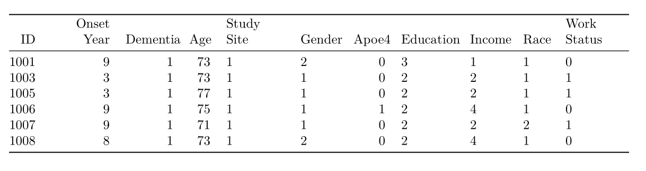

Data Processing
Each study year had different files associated with it
Some variables of interest, such as whether an individual worked for pay, were in different files with different naming conventions

Slide 6
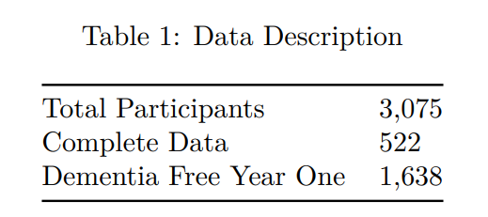

Response Variable Construction
Participants were considered to have dementia if they met any of the three following conditions
A hospital diagnosis of dementia
Prescription of dementia related medications
A 3Ms score of less than 90
The earliest year any of these criteria were met was used as the year of onset of dementia
If a patient died or was not diagnosed in the 11 year window of the study, they were assigned to have no dementia diagnosis

Slide 7

Paid Work Variable Construction
In years 1, 3, 5, 8, 9, 10, and 11, participants were asked whether they had worked for pay over the last year
A binary variable indicating whether an individual worked for pay at all over the 11 year time period was constructed

Slide 8

Survival Analysis Model
Cox Proportional Hazards Model
Methodology again set forward by Yaffe 2013
Set of predictor variables determined from theory and data availability
A model with the interaction effect with race and paid work showed improvement when compared to a model with no interaction effect (log-likelihood ratio test)
Hazard Ratios
Exponentiated model coefficient
Interpretation based on whether hazard ratio is greater of lesser than 1
Greater than 1: increased risk of dementia
Less than 1: decreased risk of dementia

Slide 9
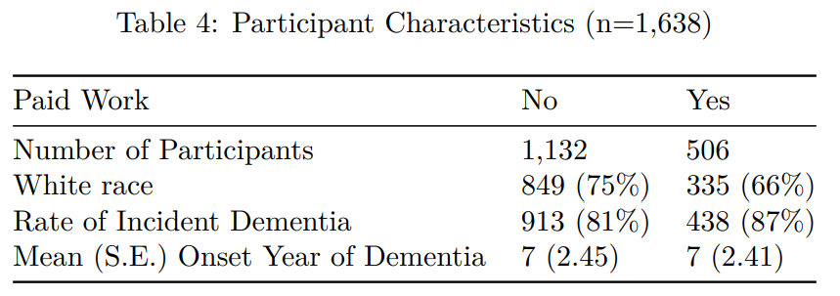

Predictor Variables
Set of variables was determined a priori based on scientific literature
Working for pay was included as a binary variable, along with the interaction effect with race
Control variables included characteristics known to be correlated with rates of incident dementia

Slide 10
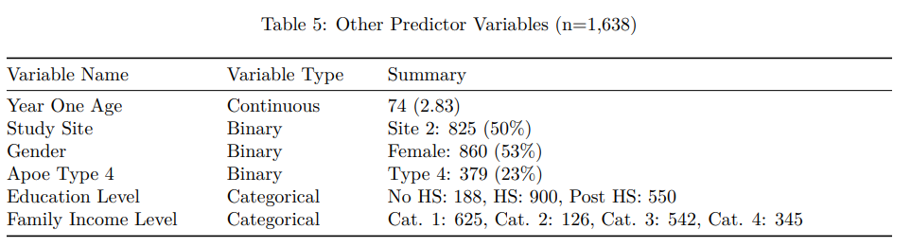

Other Predictor Variables (controls)

Slide 11

Model Diagnostics
Cox PH models have a set of mathematical assumptions
Hazards are proportional: significance tests with martingale residuals
Linear relationship between predictors and outcome: martingale residual plots
No outliers present
Study ending at 11 years precludes outlier survival times
Diagnostics were generally poor
Results should be interpreted with caution
Other studies in the dementia literature that utilize Cox PH models should be reviewed

Slide 12
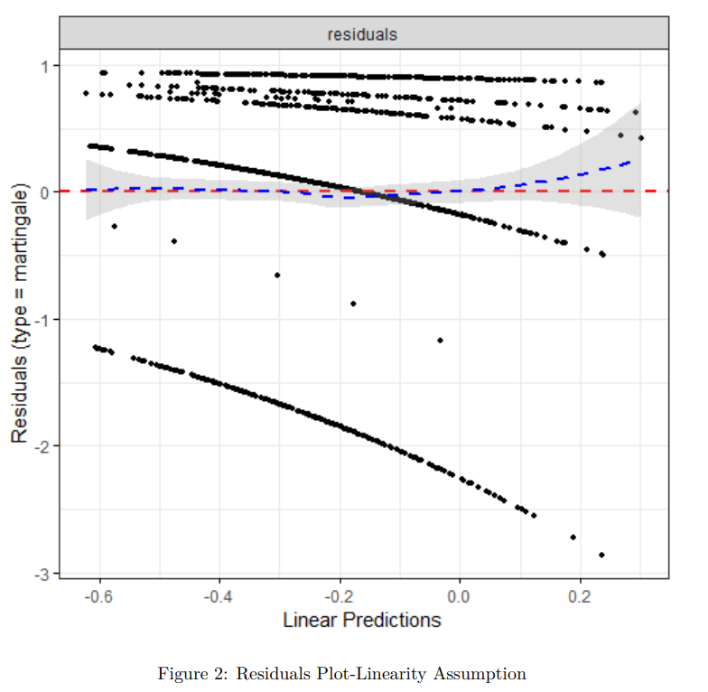

Diagnostic Plots
The martingale residual plot should be approximately linear
There was only one continuous covariate, and transformations made no significant difference
Potential research directions to address such violations will be discussed

Slide 13
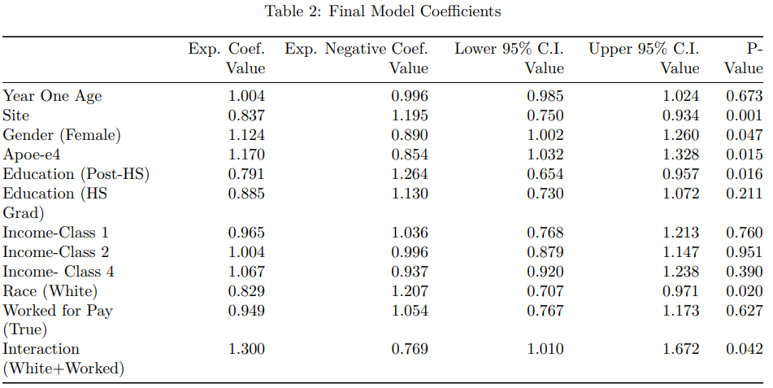

Modeling Results: Other variables
The variables used in the model had coefficients with directions that matched theoretical expectations
This gives me more confidence that the model might be useful for examining the effect of paid work, even with poor diagnostics

Slide 14
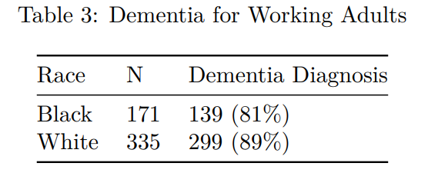

Model Results: Paid Work
The estimated effect for paid work was not significantly different from 1
The interaction effect between paid work and race was significant and the largest single coefficient estimate

Slide 15

Discussion
Despite poor diagnostics, estimated effects in model match theoretical expectations
Women, Apoe4, black adults higher risk
Higher education lower risk
Paid work had no significant effect, but the interaction effect with race was significant and large
Site location was significant. This is a proxy for location specific factors, e.g. environmental conditions

Slide 16

Future Research
Address violated assumptions
Time varying predictors for the Cox PH model to address proportional hazards assumption
Less restrictive set of survival analysis models
Account for competing risk & attrition due to death
More detailed treatments of paid work
Same model for volunteer work
Investigate paid work differences between white and black adults

Slide 17

Thank you!
References:
1. Modified Mini-Mental State Examination, Encyclopedia of Clinical Neuropsychology: https://link.springer.com/referenceworkentry/10.1007/978-0-387-79948-3_530#:~:text=The%20Modified%20Mini%2DMental%20State,and%20some%20other%20minor%20changes.
2. Effect of socioeconomic disparities on incidence of dementia among biracial older adults: prospective study, Yaffe 2013.
3. Cox Proportional Hazards Model, STHDA:http://www.sthda.com/english/wiki/cox-proportional-hazards-model
All code needed to replicate data processing and analysis is on github: https://github.com/jh-206/Consulting22_Dementia

